Slide 1

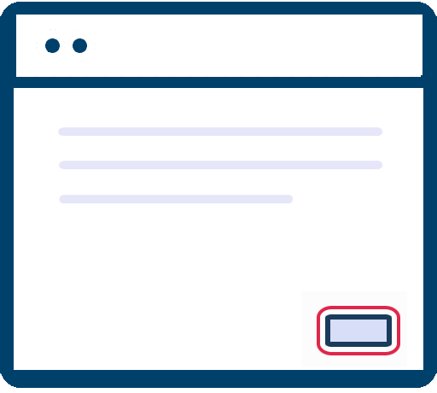
Accessibility Resource Center
February 8, 2023
Understand
Test
Solve
KEYBOARD FOCUS

Slide 2

Aaron Farber
2016: Change careers from public policy to tech. Attend App Academy.
2017-2019: Run accessibility testing/development shop focused on small businesses
2019-2020: TPGi - Accessibility Engineer
2021: TPGi - Embedded with large tech company
2022: TPGi – Accessibility Platform Consultant
Notes:
2019: Web Accessibility Specialist
2020: Certified Professional in Accessibility Core Competencies
IAAP: International Association of Accessibility Professionals

Slide 3
Learning Objectives:
1
Plan for Accessibility Testing
2
Understand Principles of Keyboard Accessibility
3
Perform Keyboard Testing
4
Questions

Slide 4
Go to tpgarc.com
Empower teams to address issues one by one while growing their understanding of accessibility over time.

Slide 5
1
Plan For Accessibility Testing
OBJECTIVE:
Create A Repeatable, Well-Defined Accessibility Testing Process

Slide 6
1
Plan For Accessibility Testing
Have A Test Plan Which Maps Testing Responsibilities to Each Role Involved in Delivering Online Experiences

Slide 7
Each month, starting today, TPGi will hold a webinar covering one group of accessibility guidelines
30 Minute Presentation – 30 Minute Q&A

Slide 8
Group Related Accessibility Guidelines
Enables testing to be done by roles with the requisite skillset
Increases efficiency and reduces duplicative work
Leads to full WCAG Coverage

Slide 9
Focus - Keyboard Testing
- Does not require a engineering background to test.
- Does not require touching code or opening Developer Tools

Slide 10
Focus - Keyboard Testing
2.1.1: Keyboard (A)
2.4.1: Bypass Blocks (A)
2.4.3: Focus Order (A)
2.4.7: Focus Visible (AA)
1.4.11: Non-text Contrast (AA) – partially covered
4.1.2: Name, Role, Value (A) – partially covered

Slide 11
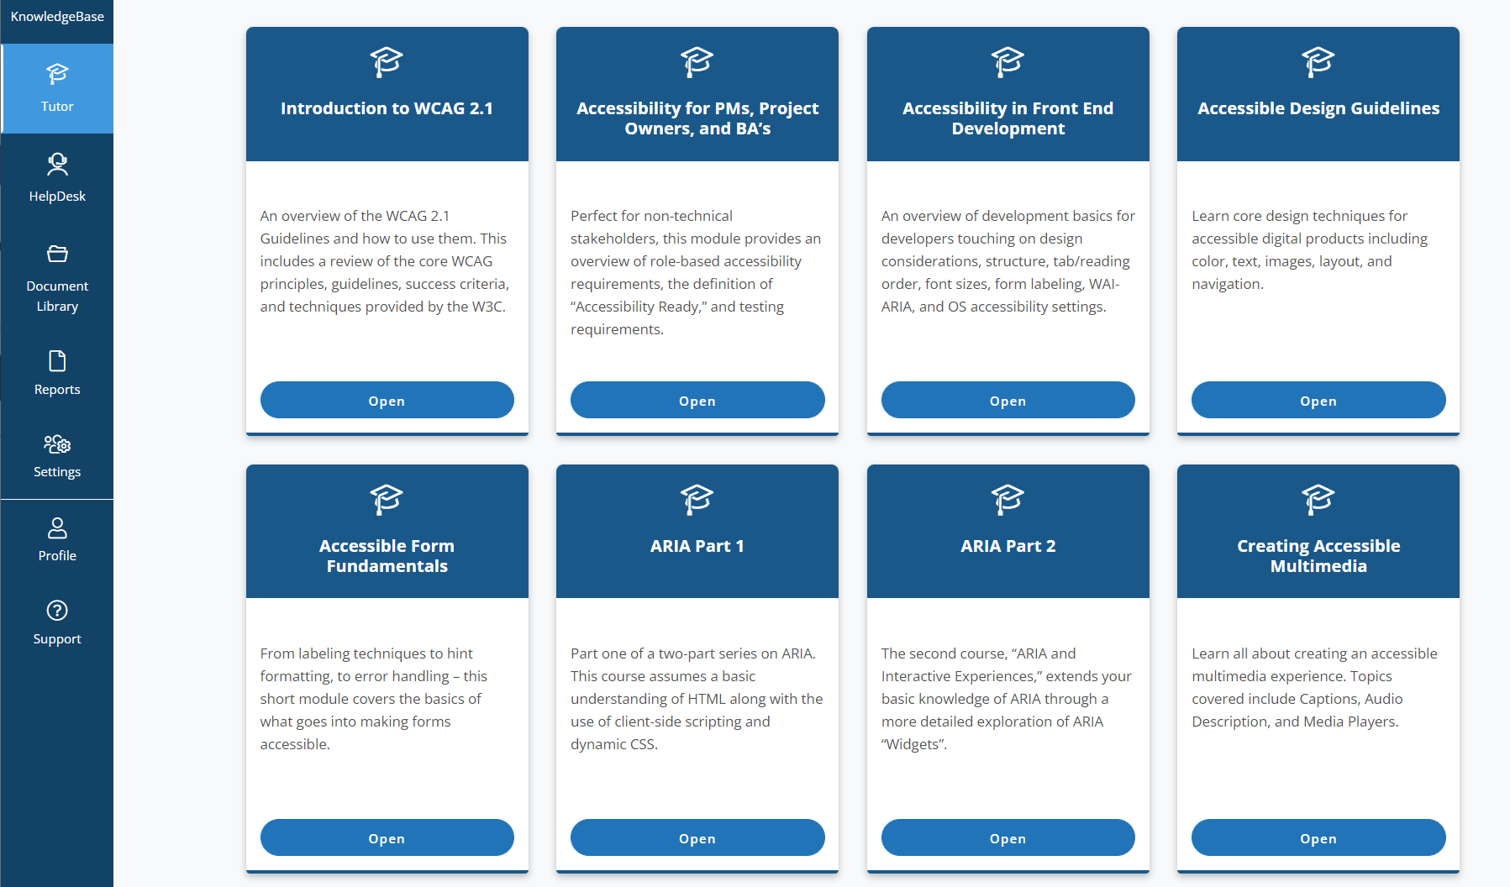
Accessibility Foundations
For Keyboard Testing: Accessibility for Product Owners, PM, and BA’s is recommended
Consume Role-Based Trainings To Understand Fundamental Principles

Slide 12
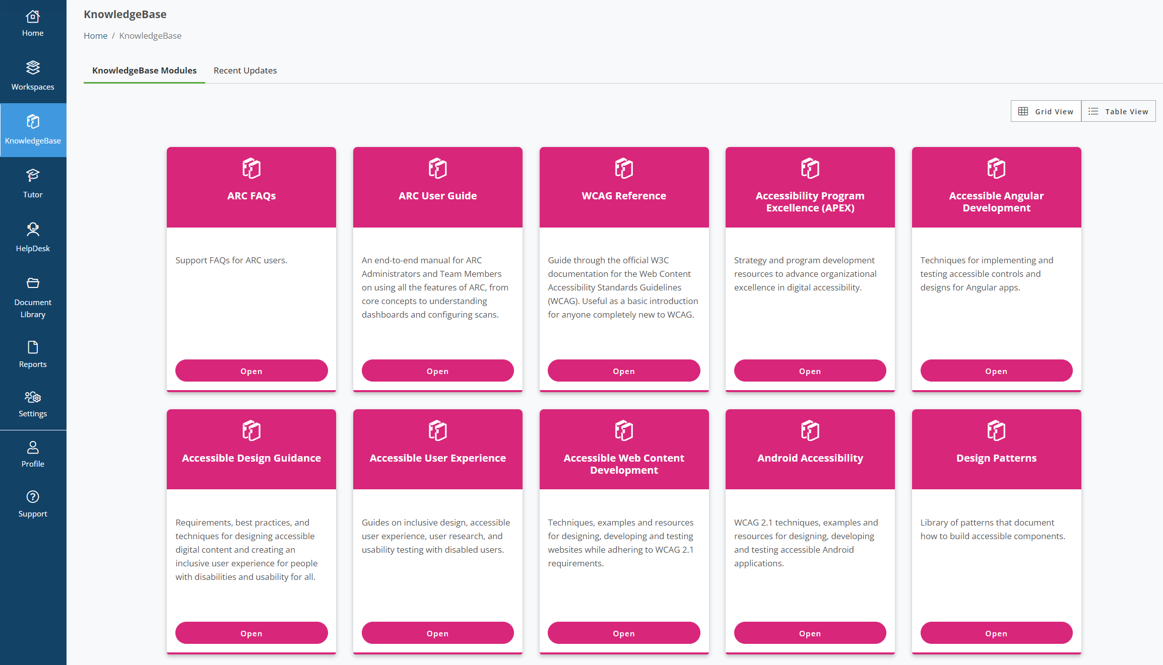
Tools and Resources
ARC’s KnowledgeBase Is Your Single Greatest Resource

Slide 13
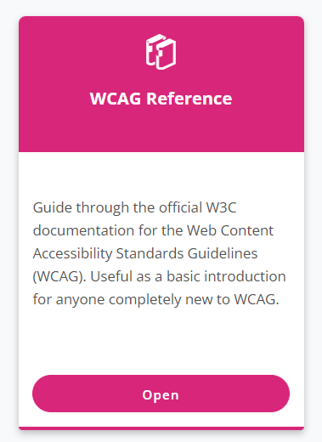
Understand
Understand The Significance of an Accessibility Guideline First
Summarizes Each Accessibility Guideline

Slide 14
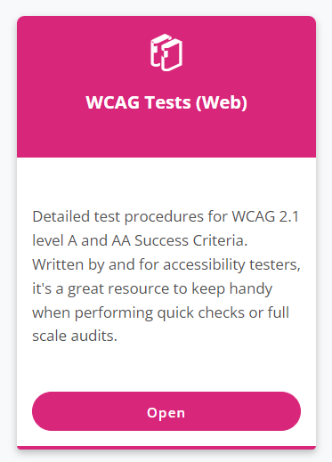
Test
Test An Issue To Determines Its Impact On User Experience
Provides Step-by-Step Manual Testing Procedure for Every Accessibility Guideline

Slide 15
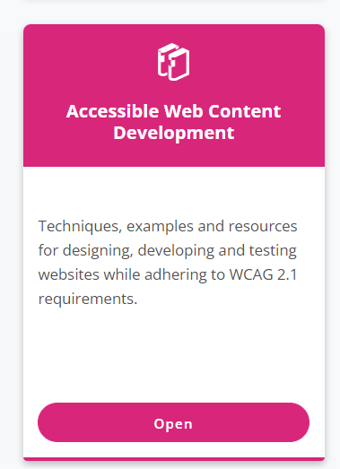
Solve
Solve an Issue with Battle-Tested, Clear Steps For Implementation
Code Samples, Expected Behaviors, Allows You to Retest and Validate the Solution

Slide 16
Keyboard Focus
Focus is the control on the screen that is currently receiving input from the keyboard.
People navigate the web, or in other words, control which element has focus by using the TAB key.
TAB to move to the next focusable element
Shift + TAB to move to the previous element

Slide 17
Key Questions
Is all site functionality accessible via keyboard?
Is it possible to skip repeated content like the navigation region?
Is the page’s focus order logical – does it follow how one would expect to interact with the page?
Is it always possible to visually determine the element that is currently focused? Is the visual indicator easily perceivable?
Are there non-interactive elements in the page’s focus order?

Slide 18
Focus Order
Order of focusable elements on the page.
Determined by the order of the elements in the DOM – when a web page loads, the browser constructs a tree structure connecting the HTML nodes on the page. This order is colloquially referred to as a page’s natural focus order.
A correct, or logical, focus order follows the visual order of elements on the screen. Some web pages may have multiple ways one could visually understand the page.

Slide 19
Focus Order
Sites may override the page’s natural focus order through:
A positive tabindex attribute on an HTML element explicitly sets that element’s position in the focus order.
A negative tabindex attribute removes an element from the focus order.
Client-side JavaScript, which sets the user to a particular location in the page.

Slide 20

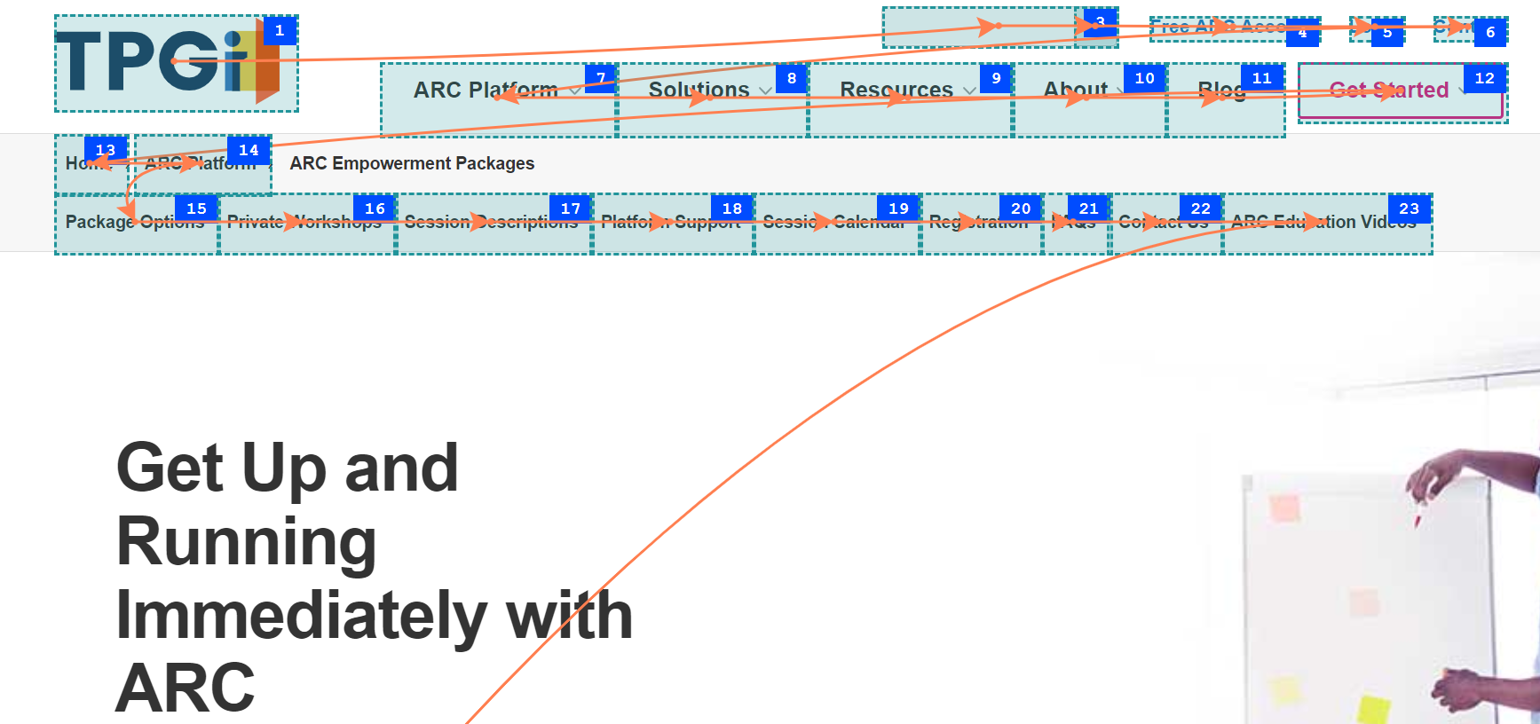
Focus Order
Visualize a page’s focus order
ARC Toolkit is a free Chrome extension.
Run ARC automated accessibility rules engine on a page.
Provides automated testing tools such as Tab Order visualizer

Slide 21
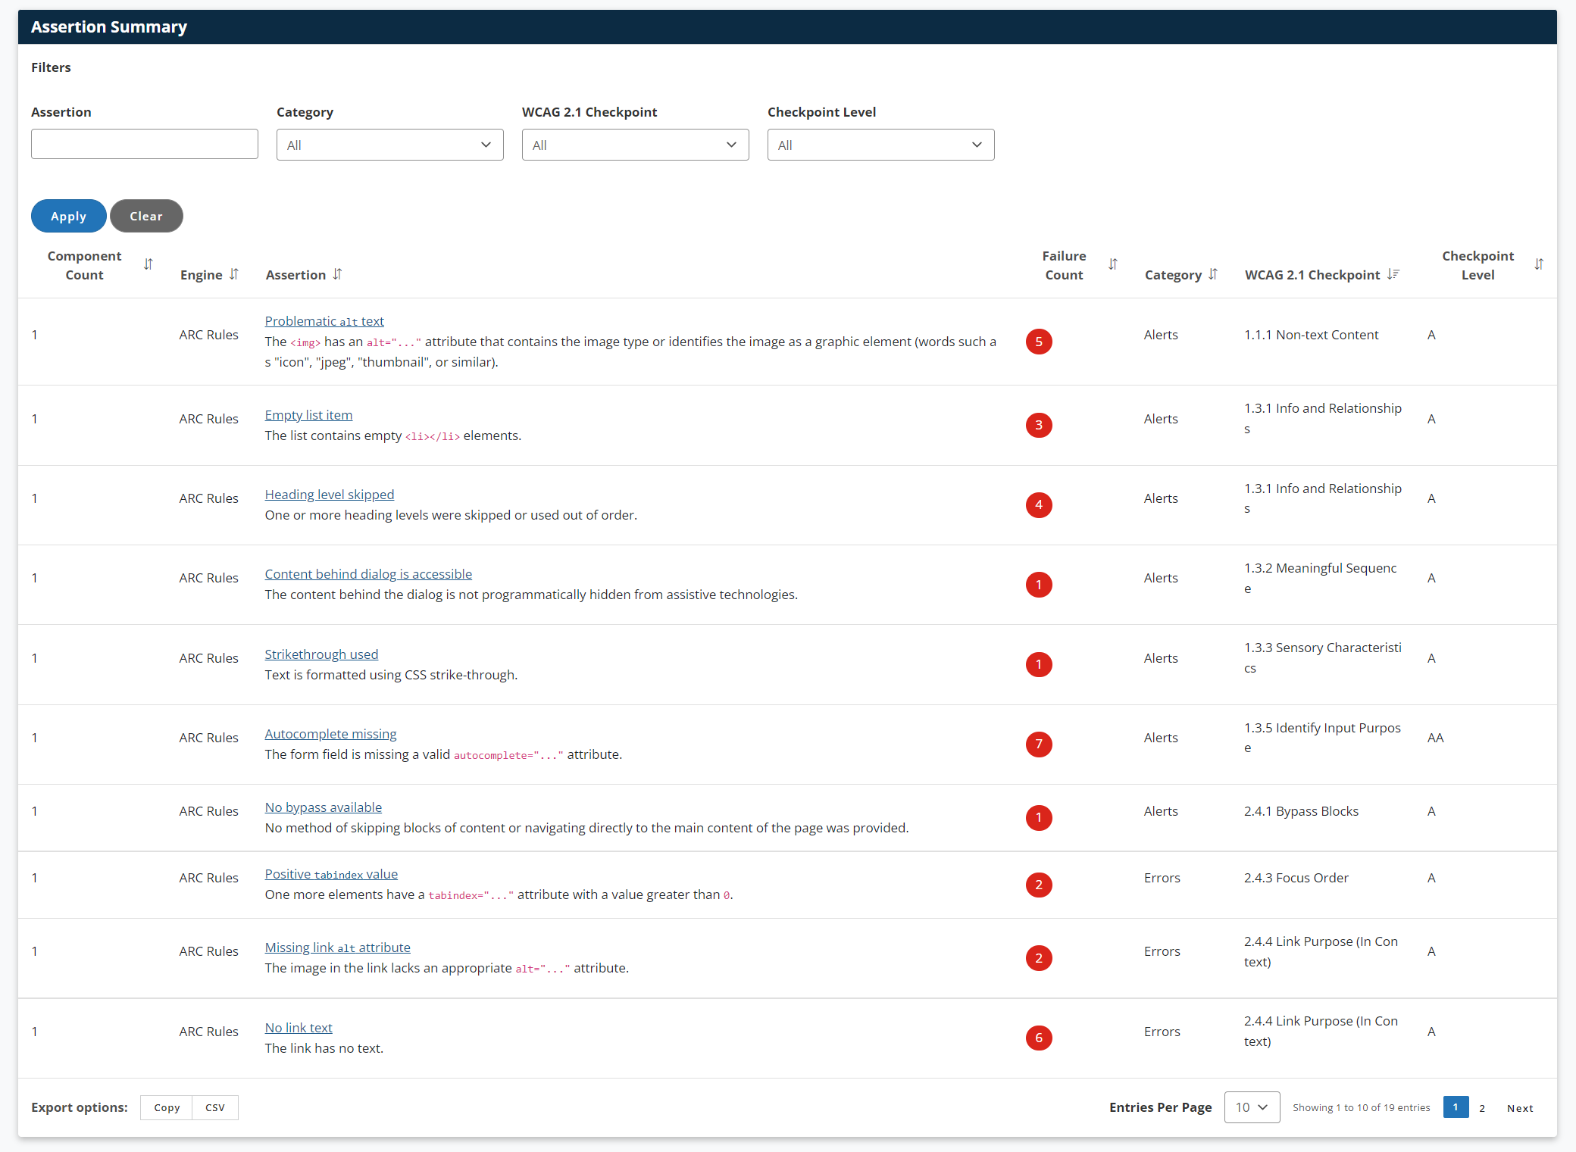
Results for a Monitoring Scan
Go one-by-one through them using
Understand
Test
Solve
BEST PRACTICE: Group related accessibility guidelines

Slide 22
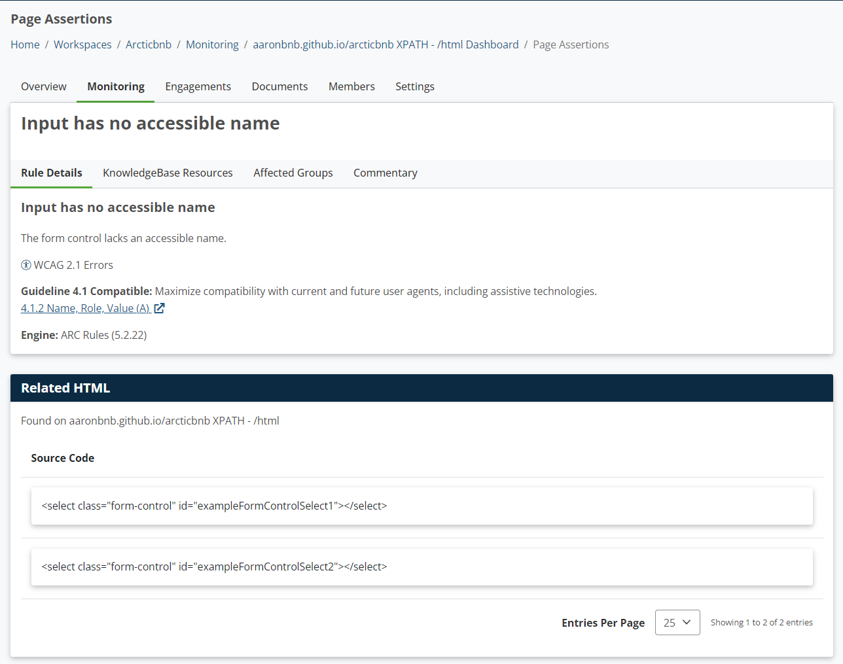
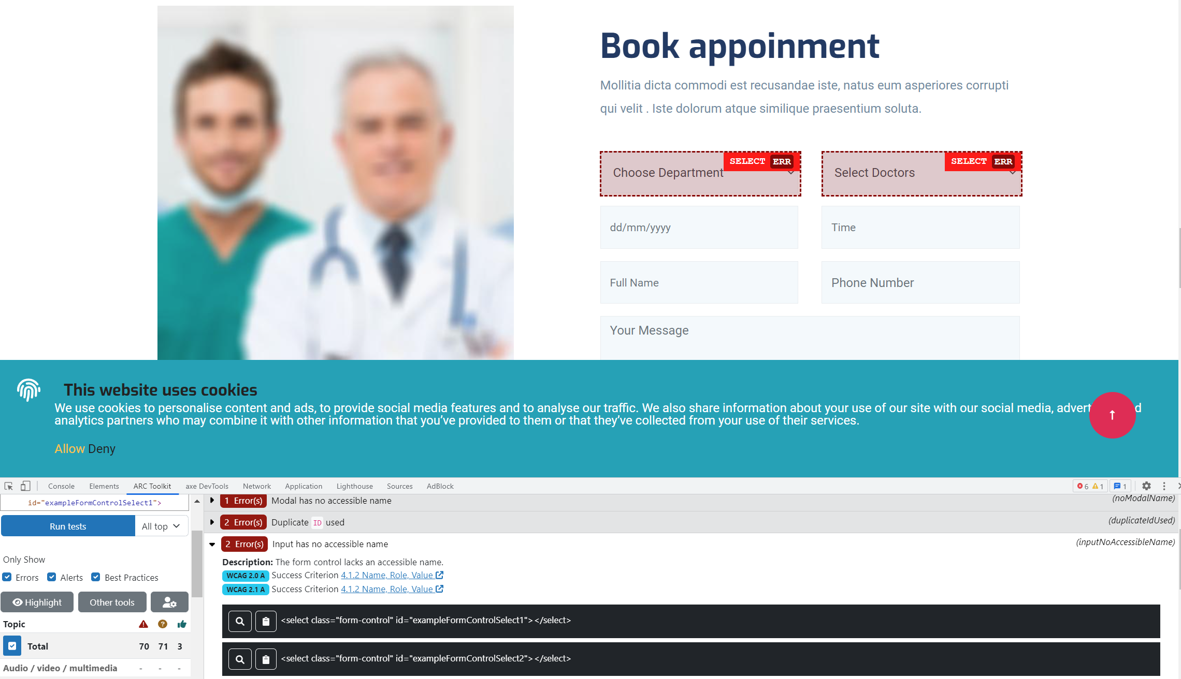
ARC Toolkit – its role in relation to ARC Monitoring
ARC Monitoring Display Test Results as HTML code snippet with access to ARC tools/resources
ARC Toolkit > Select Run Tests
Flags the element on the page
Visually inspect the element
Same issue

Slide 23
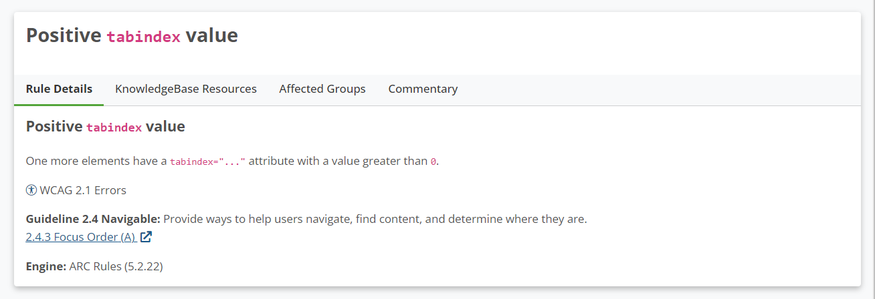
Example of an issue

Slide 24
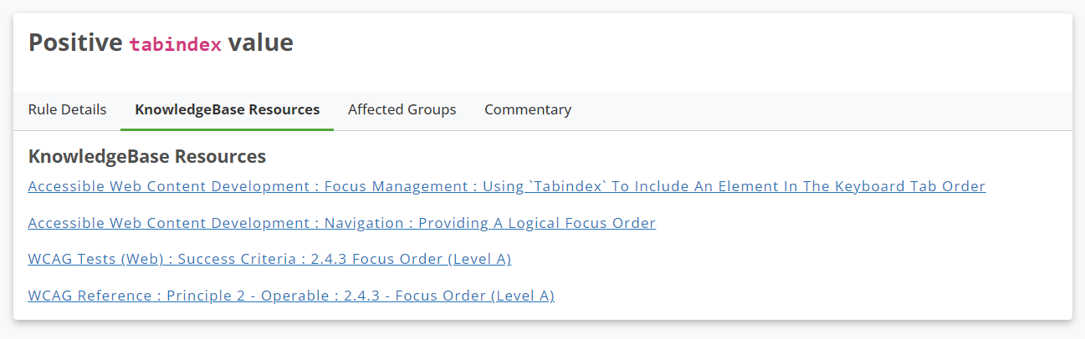
Each rule pairs with KB Resources

Slide 25
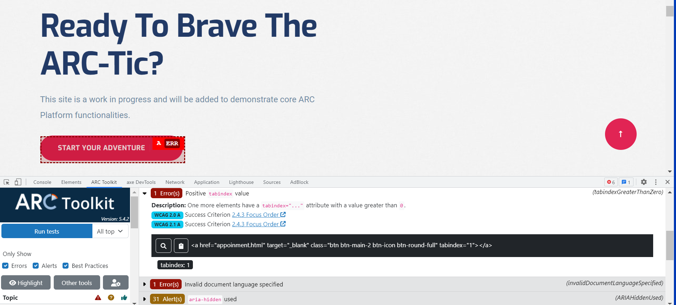
Positive Tabindex
ARC Toolkit flags the element with positive tabindex – allowing for visual inspection

Slide 26
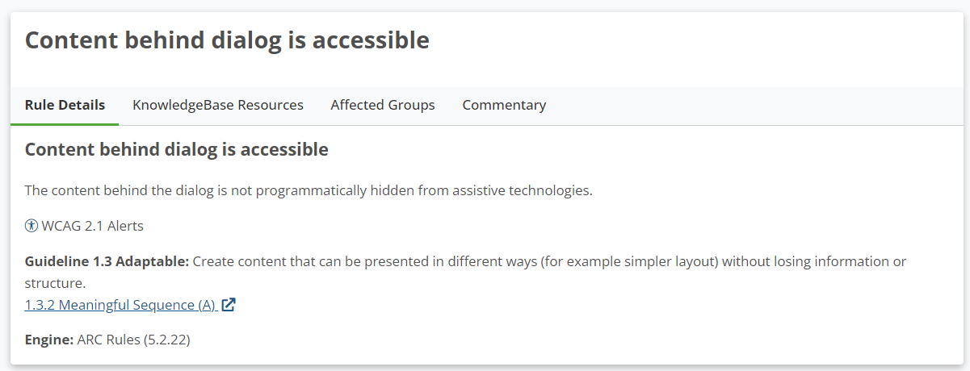
Issue 2

Slide 27
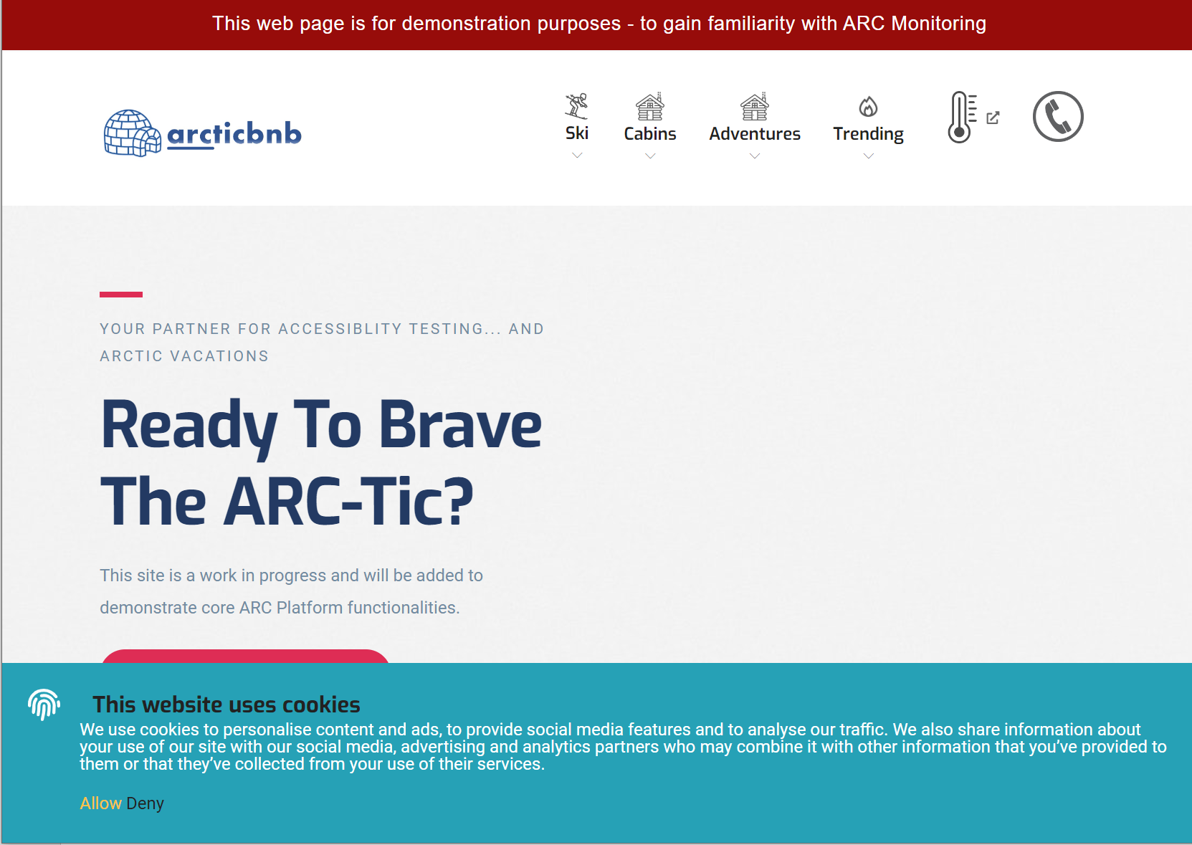
When conducting the Test manual testing procedures, testers learn of other WCAG violations which cannot be covered via automated testing alone.

Slide 28
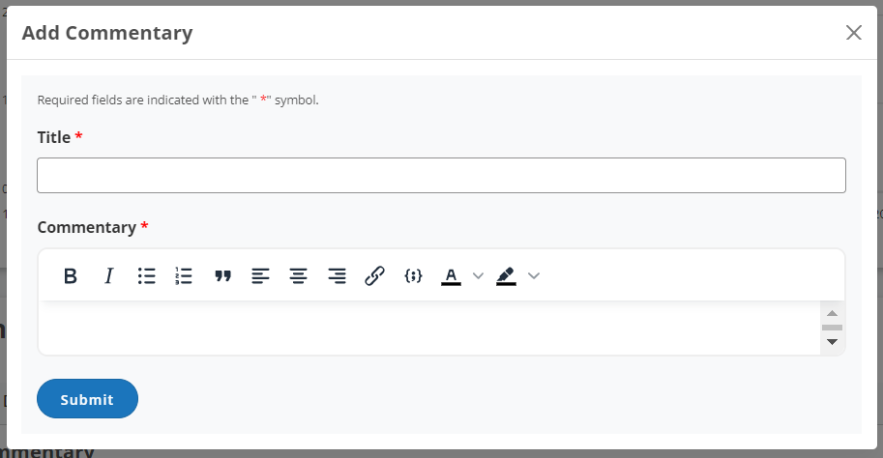
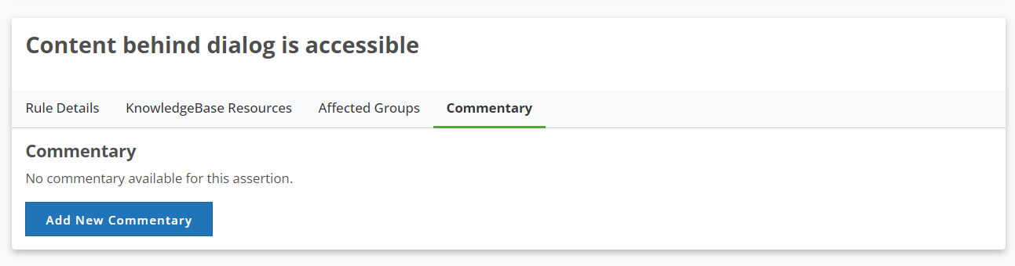
Track Progress In Near Term with Commentary
When you’ve finished inspecting an issue, write in the Commentary tab
These Notes Are Only Associated With A Single Monitoring Scan

Slide 29
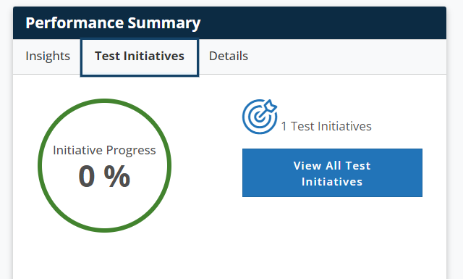
Track Progress In Long Term with Test Initiative
Only Associated With The Project – Its Whole Lifespan
Track a Particular Rule and Set a Conformance Goal

